Slide 1

Food Trends Understanding Customer Preferences
Infosys Springboard Internship Group 1 Batch 11
Data Visualization Domain
Mentor:
Ms. Nityasree
Presented by :
Flemin P Daniel
Team D

Slide 2

Objective and Project Description
Objective
• Leverage Power BI to analyze transactional and customer feedback data in the food and beverage industry
• Enable data-driven decision-making to address evolving customer preferences and operational inefficiencies
Project Description
• Identify emerging food trends and optimize menu planning based on demand and revenue performance
• Analyze customer demographics, ordering behavior, pricing sensitivity, and loyalty patterns across key cities

Slide 3

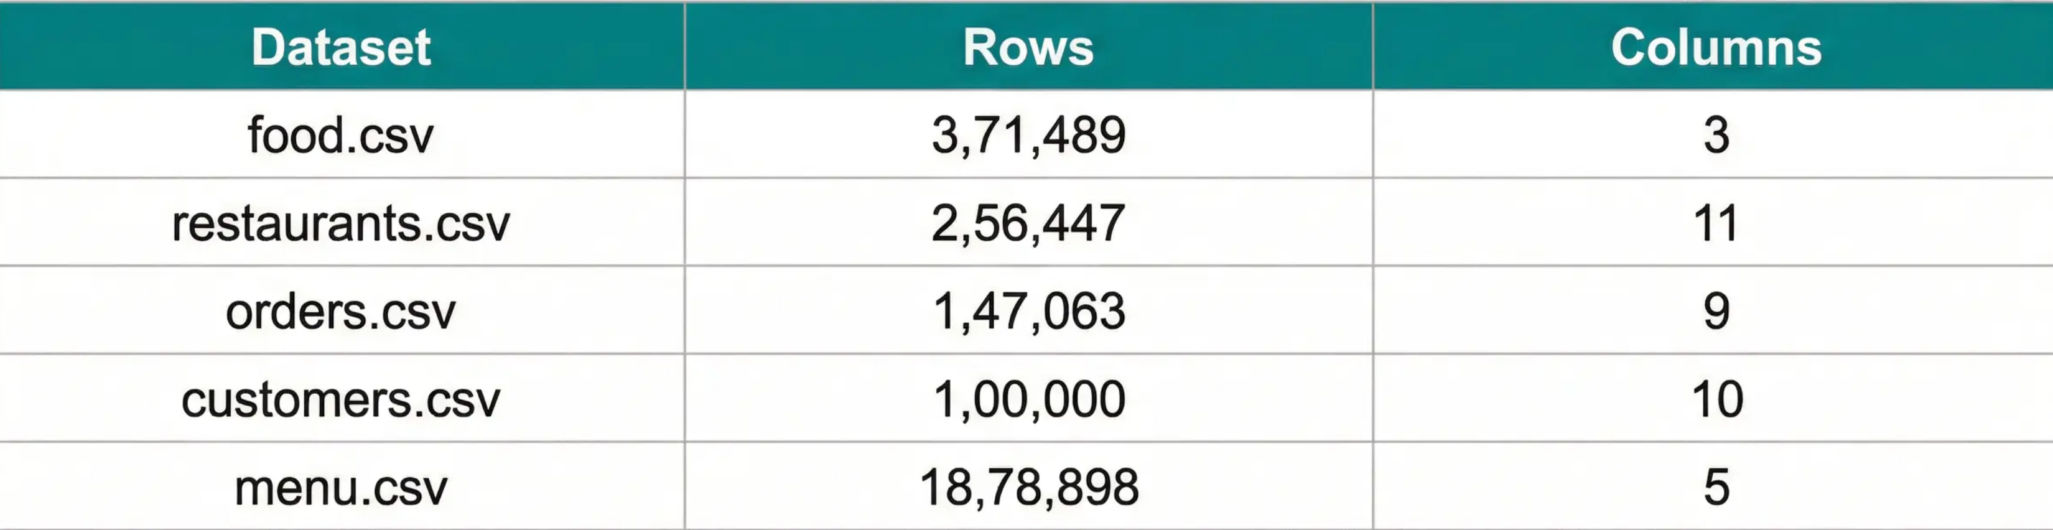
Dataset Overview
Five core datasets from Kaggle Zomato Database forming the foundation for multi-dimensional analysis across geography, demographics, and time
Key Attributes Enable:
• Customer demographic and behavioral segmentation (Age, Gender, Income, Occupation) • Location-based and quality analysis (City, Cuisine, Ratings, Cost) • Transactional timing, volume, and value tracking (Order_Date, Amount_Ruppers) • Food item characteristics and pricing analysis (Item, Veg_or_NonVeg, Price)
Total Records: 25,63,897

Slide 4

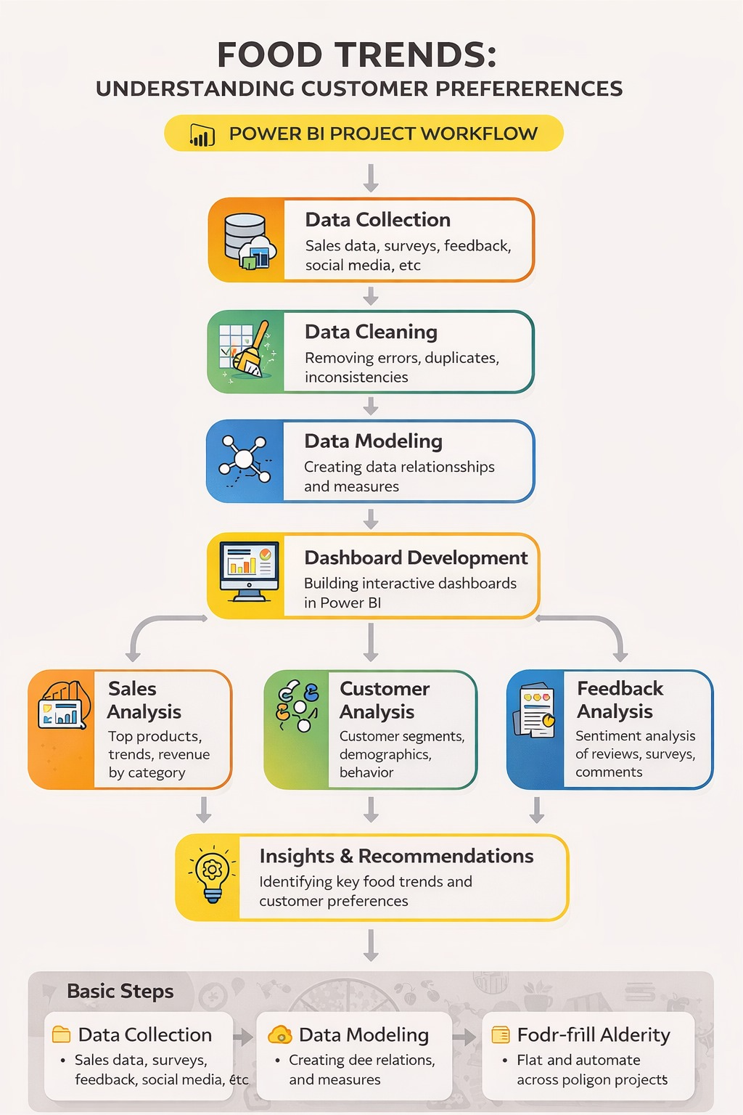
Project Workflow

Slide 5

Project Execution Milestones
Milestone 1: Data Foundation
Collected 5 tables and performed necessary preprocessing tasks like replacing null values, splitting, transformations etc.
Milestone 2: Business Overview
Developed three pages namely Business Snapshot, Customer Analysis, Restaurant Performances.
It gives overall business scenario and
Milestone 3: Ordering Behavior
Developed two pages namely Food and Menu Trends, Ordering Insights. It shows how food and ordering behavior are related.
Milestone 4: Customer Demographics
Added two pages namely Customer Loyalty and Customer Demographics.
Visual formatting has been improved for all the pages

Slide 6




Challenges Faced and Resolution
Addressed data inconsistencies, multi-valued fields, and missing metrics through cleaning, transformation, and enrichment, ensuring analytical accuracy and reliability
Data Cleaning
Data Transformation
Data Enrichment
Challenge: Inconsistent formatting and null values in critical columns (Rating, City, Cuisine)
Challenge: Inconsistent formatting and null values in critical columns (Rating, City, Cuisine)
Challenge: Inconsistent formatting and null values in critical columns (Rating, City, Cuisine)
Challenge: Multi-valued Cuisine and City fields, ambiguous Menu_ID and RID relationships
Challenge: Multi-valued Cuisine and City fields, ambiguous Menu_ID and RID relationships
Challenge: Multi-valued Cuisine and City fields, ambiguous Menu_ID and RID relationships
Challenge: Currency inconsistency (INR/USD), lack of day-of-week data, incomparable ranges
Resolution: Text trimming, duplicate removal, created New_Restaurant column for null ratings
Resolution: Text trimming, duplicate removal, created New_Restaurant column for null ratings
Resolution: Text trimming, duplicate removal, created New_Restaurant column for null ratings
Resolution: Split and unpivot multi-valued fields, explicit relationship definitions in Power BI
Resolution: Split and unpivot multi-valued fields, explicit relationship definitions in Power BI
Resolution: Split and unpivot multi-valued fields, explicit relationship definitions in Power BI
Resolution: Created Amount_Rupees, Order_Day, and Income_Bound columns for unified analysis
Comprehensive data preprocessing ensured reliable foundation for accurate business intelligence analysis

Slide 7



Key Insights and Feature Enhancement
Strategic Insights
Strategic Recommendations
• Revenue declined from ₹41.75M (2018) to ₹14.59M (2020)
• Launch 'Weekend Family Bundles' for low-performing days
• Friday peak: 34.5K orders vs. weekend drops
• Implement 'Student Prime' Loyalty Program
• Students drive highest revenue despite low income
• Expand into Tier-2 cities (Raipur, Hyderabad)
• Quality perception matters more than price
• Incentivize user reviews with discount campaigns
Data-driven strategies to reverse declining trends and enhance customer retention

Slide 8
Acknowledgement and References
We would like to express our heartfelt gratitude to:
Infosys Springboard Team– for organizing this valuable internship opportunity.
Our Mentor– for her continuous support and feedback.
My Teammates – for collaboration, encouragement, and insights This internship has been a significant step in our professional growth and technical journey.
All data, analysis, and insights presented in this report are based on internal project documentation provided, including:
Kaggle Zomato Dataset
Microsoft Power BI Documentation
Infosys Springboard Virtual Internship course materials

Slide 9



Conclusion
• Successfully transformed raw transactional data into comprehensive and interactive visual dashboards
• Delivered actionable insights into food trends, customer preferences, and operational patterns
• Enabled deep understanding of customer behavior, revenue drivers, and market dynamics
Data-driven approach transforms business intelligence into competitive advantage

Slide 10
Thank You

